Slide 1

Introduction Service Learning –
Definition and Orientation

Slide 2
Service Learning - Definition
"The basic theory of service-learning is Dewey’s: the interaction of knowledge and skills with experience is key to learning. Students learn best not by reading the Great Books in a closed room but by opening the doors and windows of experience. Learning starts with a problem and continues with the application of increasingly complex ideas and increasingly sophisticated skills to increasingly complicated problems.”
Thomas Ehrlich, in Barbara Jacoby and Associates. 1996.

Slide 3
Service Learning - Definition
“Service-learning is a teaching method which combines community service with academic instruction as it focuses on critical, reflective thinking and civic responsibility. Service-learning programs involve students in organized community service that addresses local needs, while developing their academic skills, sense of civic responsibility, and commitment to the community.”
Campus Compact National Center for Community Colleges

Slide 4
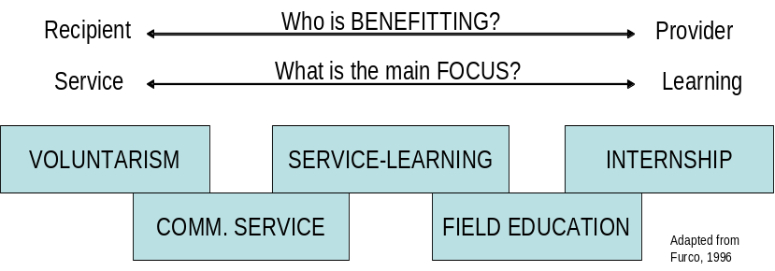
Service Learning - Introduction
Method of experiential education, linking classes with local society
SL asks students, to implement theory in practice
Helps to understand and reflect complex topics on various scales
Reflection and reciprocity are central concepts of service learning

Slide 5
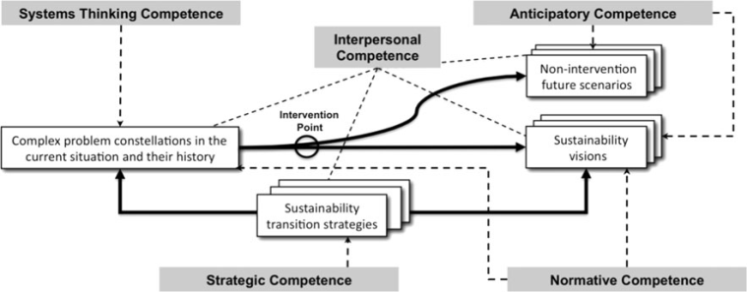
Service-Learning
Outcomes for Learners
Engagement in society is fostered, networks and connections are created
Holistic perspective is aimed
Individual personal development
Communication skills and group competencies
Awareness of complexity, problem analysis skills, critical thinking and cognitive development
Capacity development for enhancing change
Professional development for career
Key competencies in sustainability
(Wiek et.al, 2012)

Slide 6
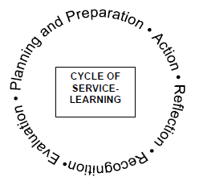
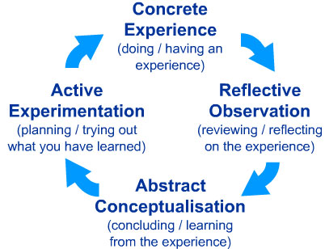
Service Learning – Orientation
Coaching involves four phases
Preparation
Action
Reflection
Evaluation
The Experiential Learning Cycle
Kolb (1984)

Slide 7
Cooperation with Service Learning Partners, Project und group organization

Slide 8
Cooperation Partners
...can be companies, associations, NGOs or public bodies. Projects can focuse for instance on…
Tasks project partners: contact person for student group, personal meetings in work environment, presentation work field (current challenges), continuous feedback process
Focus of cooperation: not only output is important but learning process, learning from each other, talk about expectations, progress etc.
Community Development
Sustainability-driven Entrepreneurship
Bottom-Up Change

Slide 9
Tasks for semester I
To develop realistic service learning projects together with service learning partners
Drafting the first ideas of possible project at a poster
Elaborating the project design through interviews and „real life checks“ all over the semester
Adjusting the original project design and making a new poster
Presenting the (two)poster(s) and the learning process at the end of the course (oral presentation)
Notes:
9

Slide 10
Group Work
Self-organized group work during semester
Select contact person in your group (for service learning partner and coach)
Organize first collective meeting with students, partner and coach
Further meetings during the semester with coach based on individual needs
Self-organized continuous meetings with your group and together with service learning partner min. 1-2 per month

Slide 11
Group Work and Coordination
  Discuss and start from the beginning
  Allocation of roles in group/responsibilities
  Expectation management (also with Partner!!!)
  Develop time management plan
  Fair division of work
  Write protocols during meetings (use for research diary and reflection)

Slide 12
Project Concept (group task)
Structure project concept
Presentation of problem
Project aim
Measures and methods
Stakeholder analysis
Team organisation and time management
How to conduct the project concept?
Via ongoing group work process during semester
  Self-organized group meetings
  Self-organized meetings with service learning partners
  feedback meetings with coach

Slide 13
Research Diary (individual task)
From the beginning on keep an individual updated service-learning research diary
Write memos when you meet your group and/or partners
Write down your thoughts/hypotheses during literature research/practical research e.g. at site (oberservations, talks etc.)
Use key questions in template for diary

